Slide 1
Office Supplies Project
Author: Tales Gomes – Data Analyst

Slide 2
The problem
Context
Problem description
Problem analysis
23% drop in revenue in the past year.
Warehouses in four regions and all four warehouses stock the same products.
Possible large amounts of unsold products in some locations.
Look at the product sold by region and verify if any is not sold.
Verify the most popular products per region
Analyze year trend by region and category

Slide 3
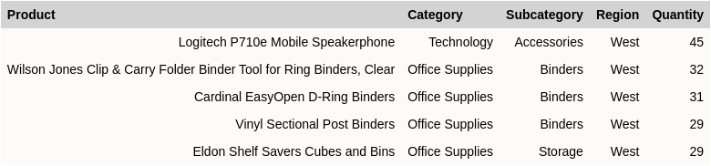
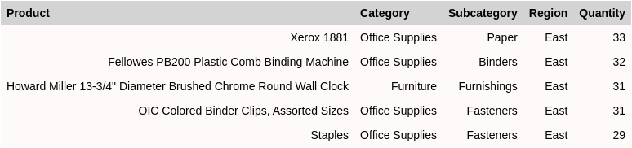
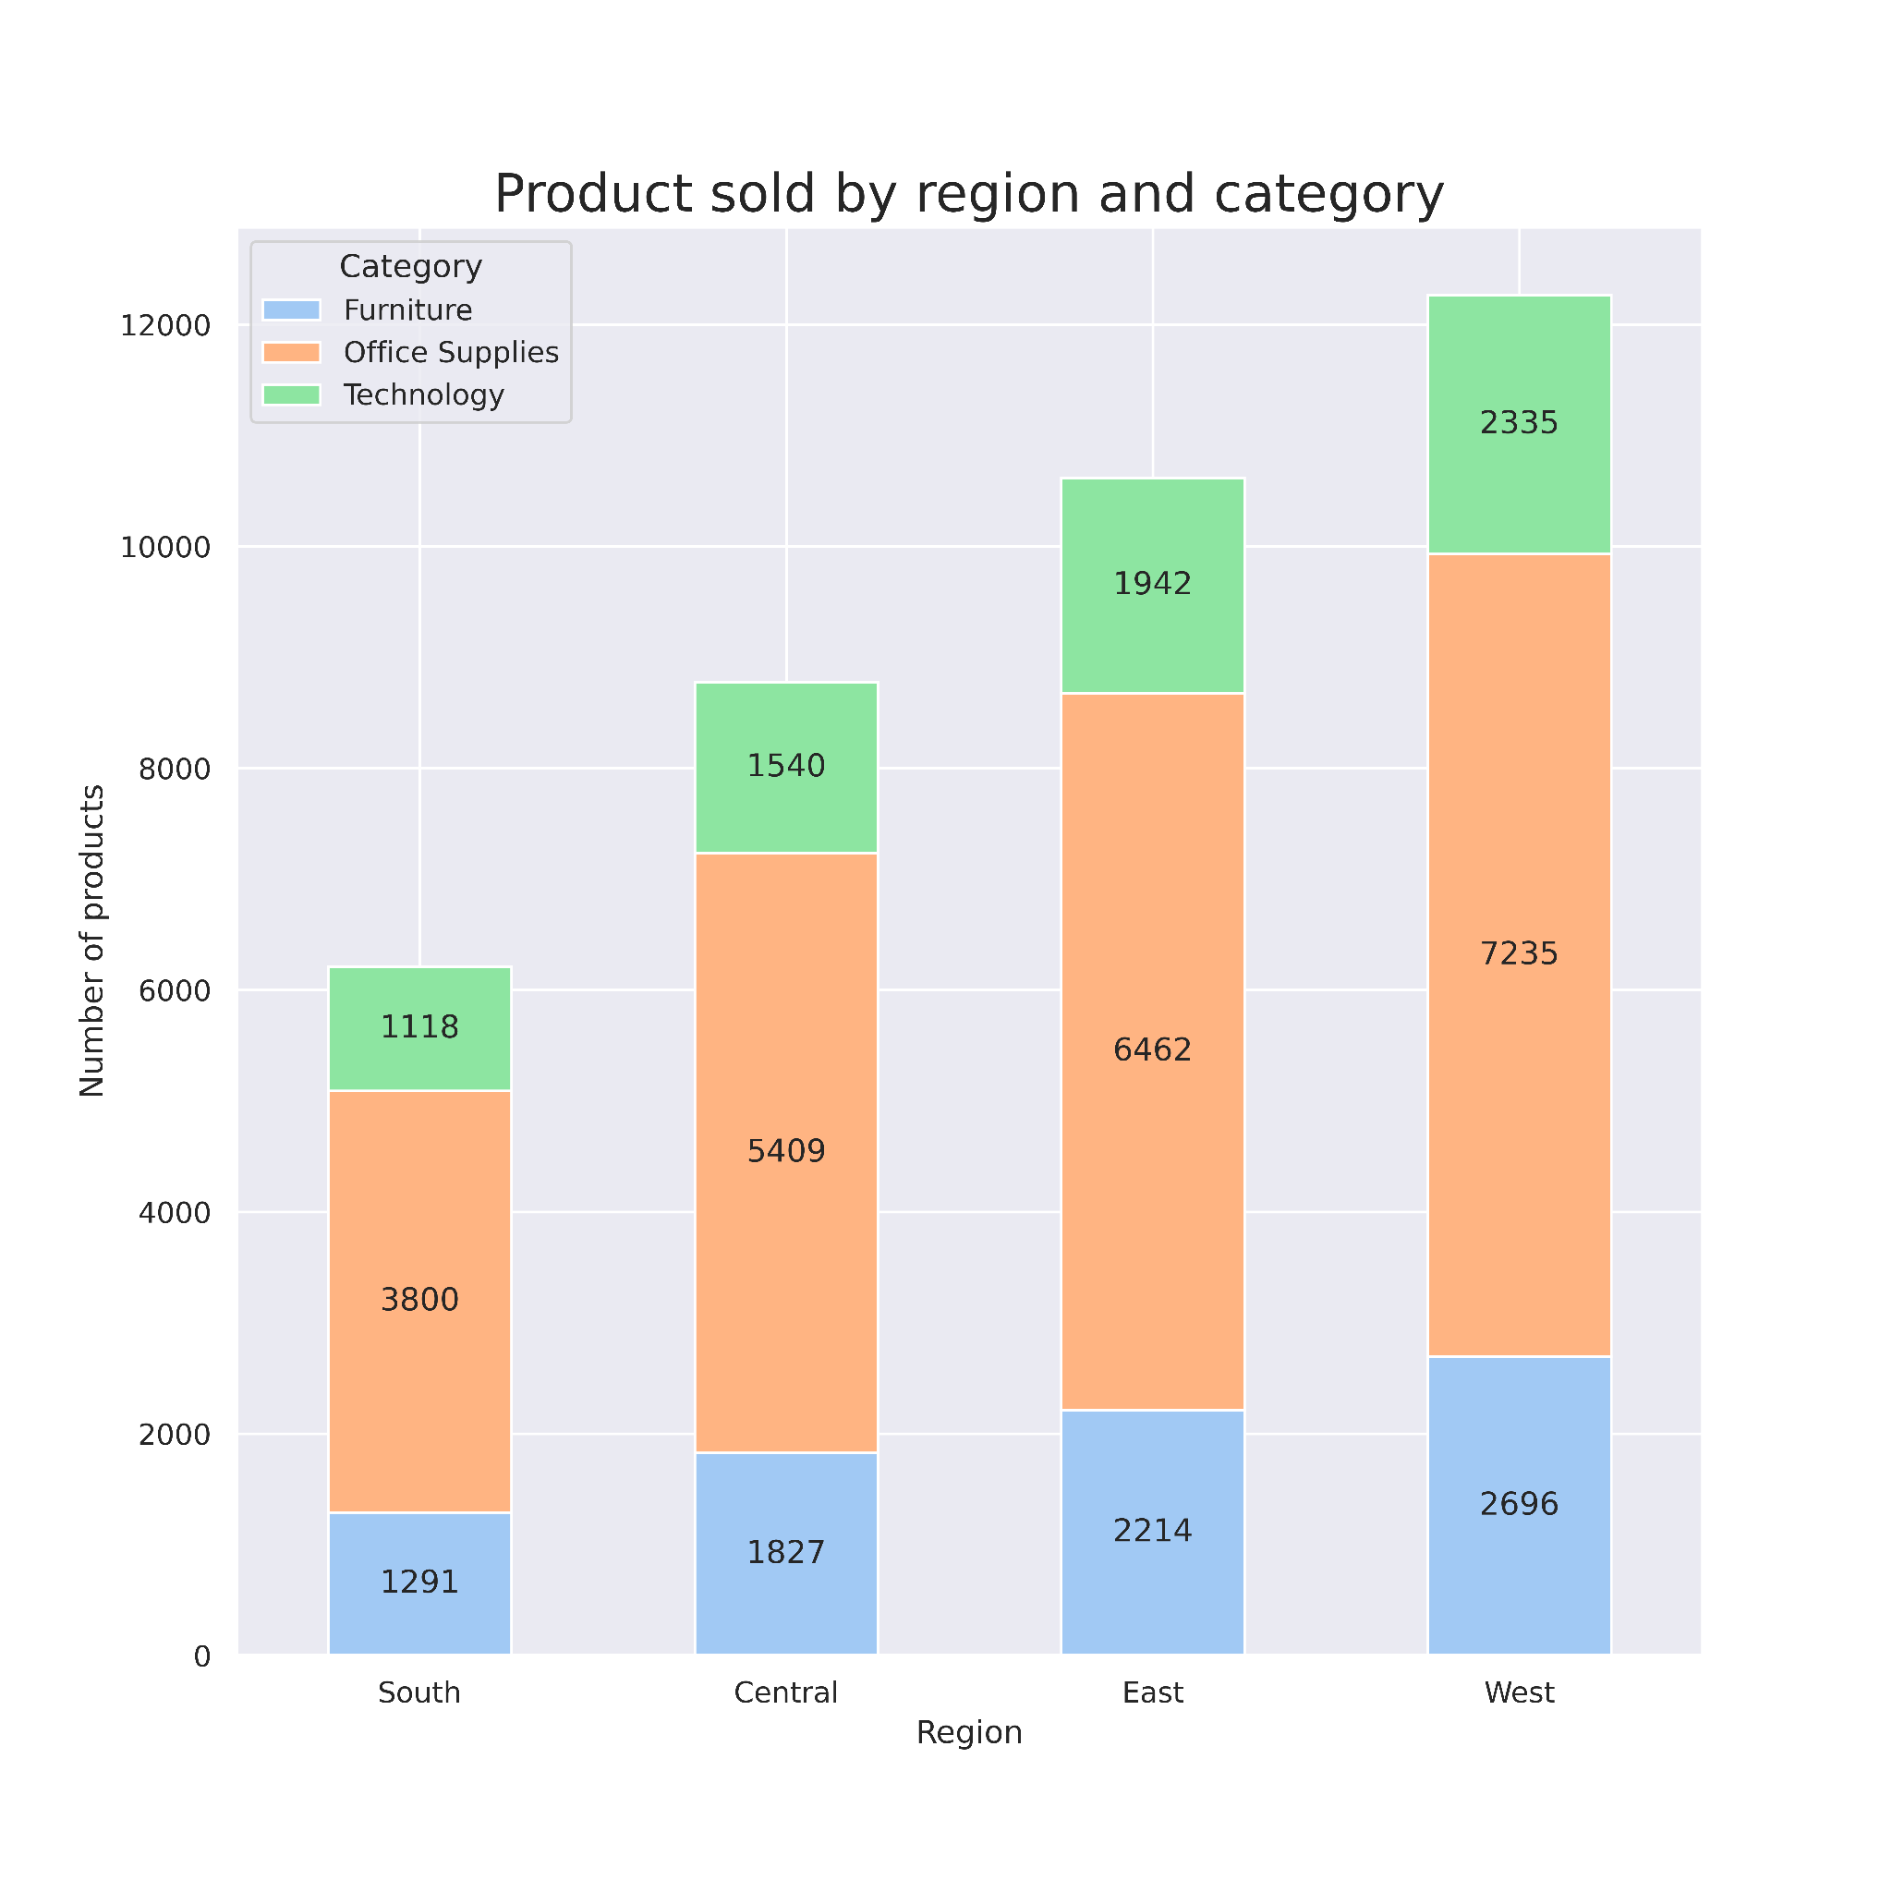
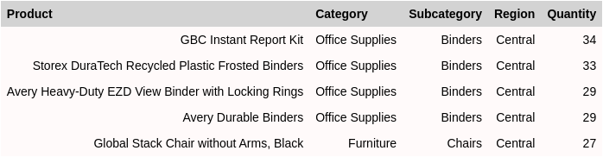
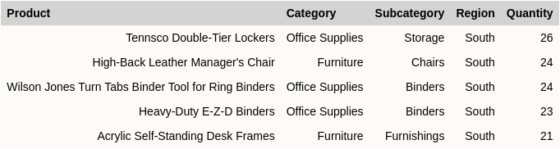
West
Most popular products per region
East
Central
South
The Logitech P710e Speakerphone is the most popular item in the West area, Tennsco Double-Tier Lockers in the South area, Xerox 1881 printer in the East area and GBC Instant Report Kit is the most popular product in the Central area.

Slide 4
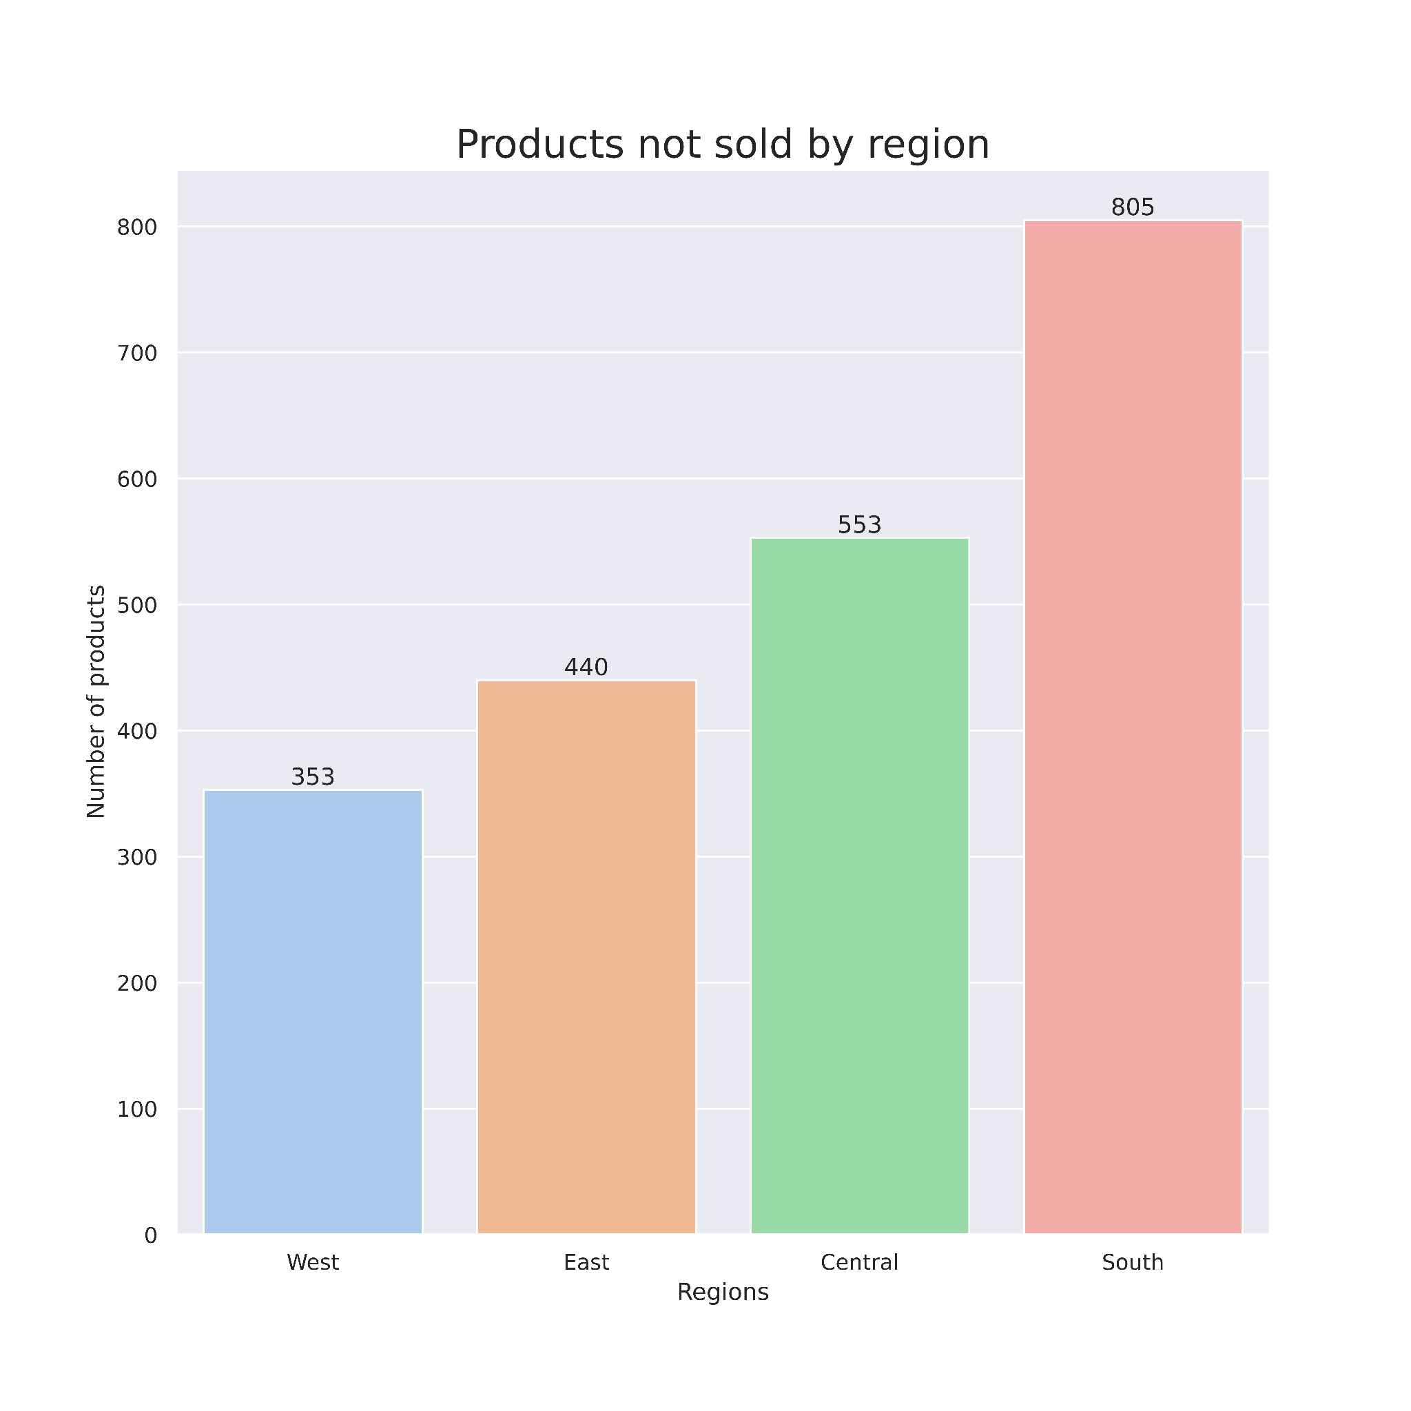
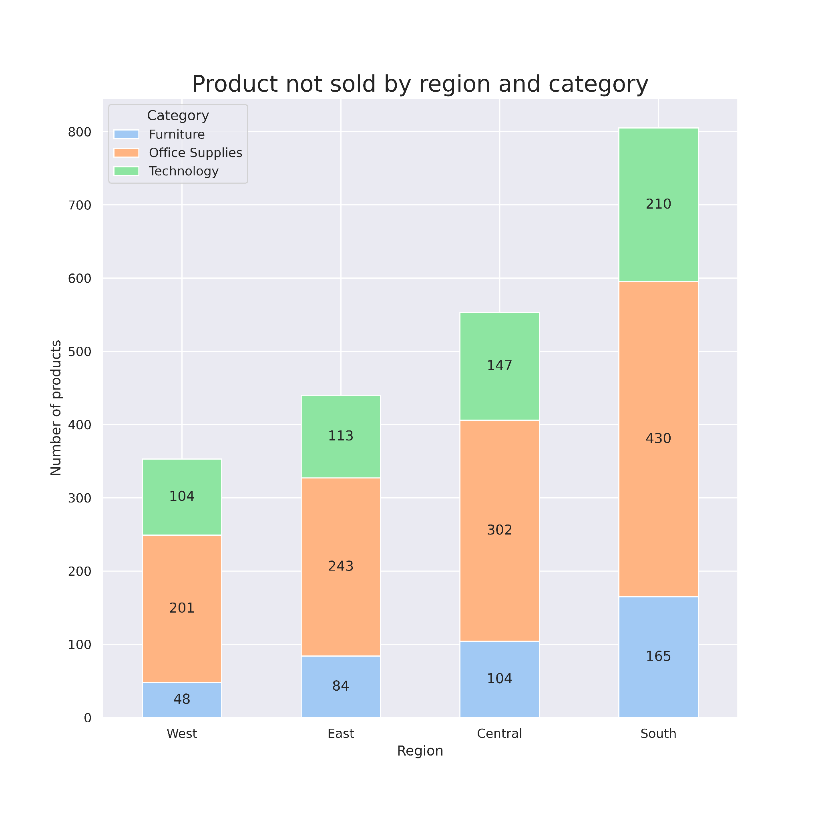
Products not sold per region
There are 1862 different products in the dataset. West region did not sell 19% of this, East region 24%, Central region 30% and South region did not sell 43% of the total.
All products are present in at least one region, however, there are several products sold in only one region.
There are 28 products only sold in the Central region, 23 in the South region, 59 in the West region and 53 products only sold in the East region.

Slide 5
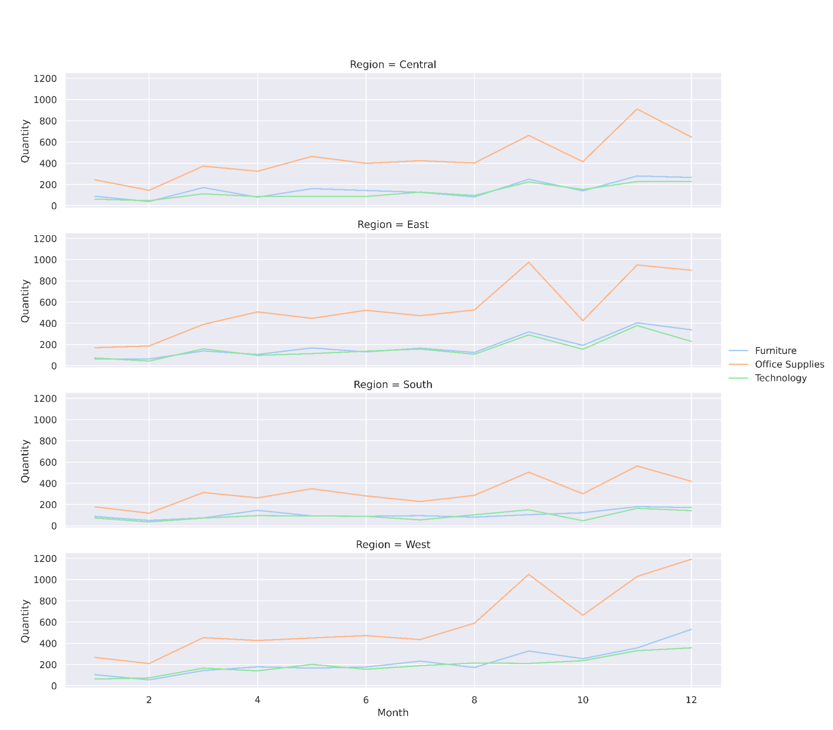
Annual sales trend by region and category
Annual sales trend
The sales have the bottom in the months of January and February in all four regions.
There are two annual sales peaks, the first in September and the second in November, except in the west region, which peaks in December.

Slide 6
Recommendations
Adjust inventories for each region taking into account products that are not sold in that region, as well as products that are only sold in that region
Spread the inventory of each Warehouse based on the popularity of each product in that region
Tune the logistics to reflect the seasonality of annual sales, taking into account the lows at the beginning of the year and the highs of September, November and December.

Slide 7
Thank you

